Slide 1

7th Grade Math
Unit 5, Lesson 2 Determining Probability Volume 1, pg. 185

Slide 2


Benchmarks
MA.7.DP.1.3
Given categorical data from a random sample, use proportional relationships to make predictions about a population.
MA.7.DP.2.4
Use a simulation of a simple experiment to find experimental probabilities and compare them to theoretical probabilities.
volume 1, pg. 185

Slide 3
Integrated Mathematical Thinking and Reasoning Standards
MA.K12.MTR.1.1 Actively participate in effortful learning both individually and collectively.
MA.K12.MTR.2.1 Demonstrate understanding by representing problems in multiple ways.
MA.K12.MTR.4.1 Engage in discussions that reflect on the mathematical thinking of self and others.
MA.K12.MTR.7.1 Apply mathematics to real-world contexts.
volume 1, pg. 185

Slide 4

Learning Target
I can determine the probability of an event happening using data.
volume 1, pg. 185

Slide 5

Warm-Up
volume 1, pg. 185

Slide 6
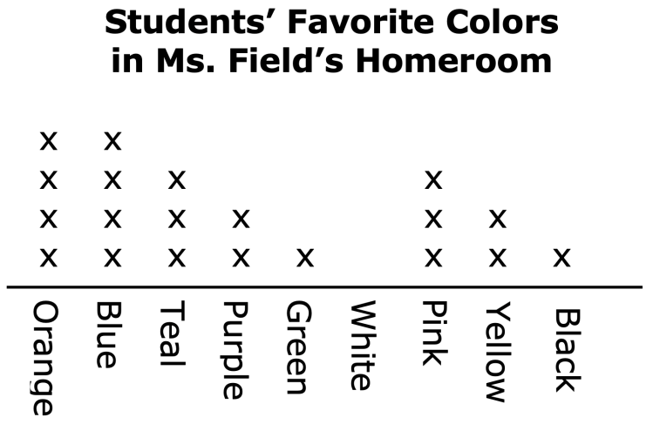
5.2.1 Warm-Up: Line Plot
Ms. Field asked the students in her homeroom to make a line plot showing their favorite colors. Each x above a color represents one student’s response.
volume 1, pg. 185
Notes:
Video Link: https://algebranation.wistia.com/medias/fi4fidi5y8

Slide 7
How many students are in Ms. Field’s homeroom?
What fraction of students like pink best?
Show how to calculate the percent of students who say green is their favorite color.
volume 1, pg. 185
Notes:
Video Link: https://algebranation.wistia.com/medias/fi4fidi5y8

Slide 8

Guided Instruction
volume 1, pg. 186

Slide 9

5.2.2 Guided Instruction: Determine the Probability of an Event
The probability of an event tells us how likely that event is to happen.
Match the probabilities with the event described. Write the letter of the event in the space next to the probability of it occurring.
volume 1, pg. 186

Slide 10
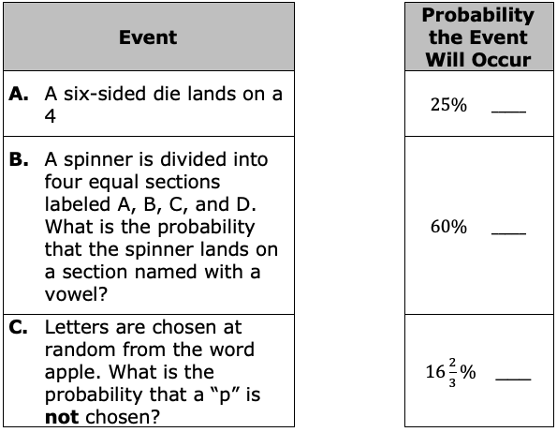
volume 1, pg. 186

Slide 11
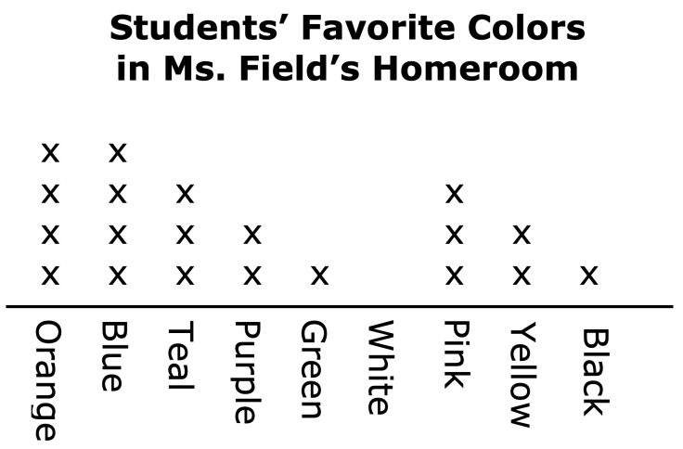
Data can also be used to determine the probability of an event. Here is an example using the line plot from the warm-up.
The line plot can be used to find the probability that a student in Ms. Field’s homeroom, chosen at random, picked purple as their favorite color.
volume 1, pg. 186

Slide 12
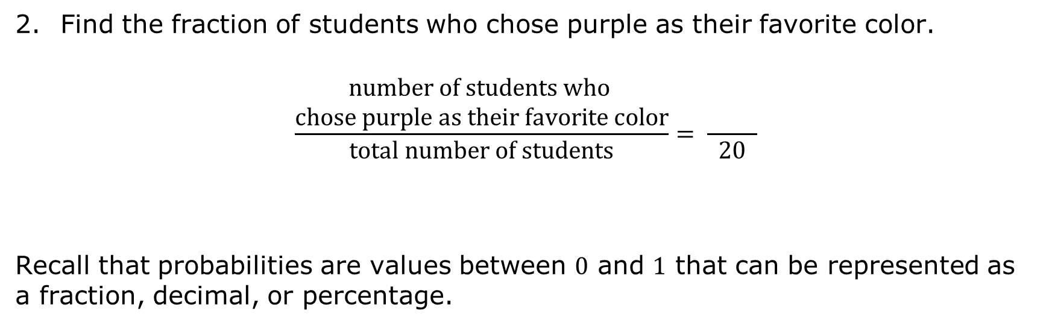
Find the fraction of students who chose purple as their favorite color.
$$\frac{\begin{aligned}number of students who \\ chose purple as their favorite color\end{aligned}}{total number of students}= \frac{ }{ 20 }$$
Recall that probabilities are values between $0$ and $1$ that can be represented as a fraction, decimal, or percentage.
volume 1, pg. 186

Slide 13
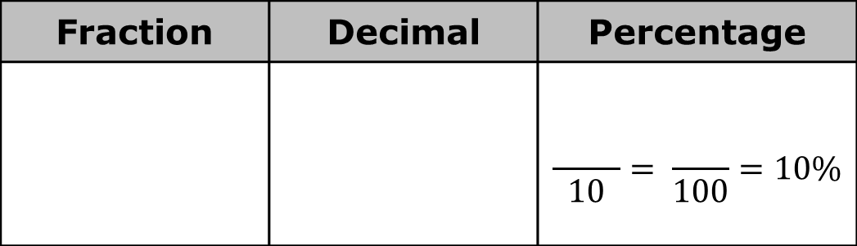
Express the probability in each form.
Fraction | Decimal | Percentage
 |  | $$\frac{ }{ 10 }= \frac{ }{100}=10\%$$
volume 1, pg. 186

Slide 14
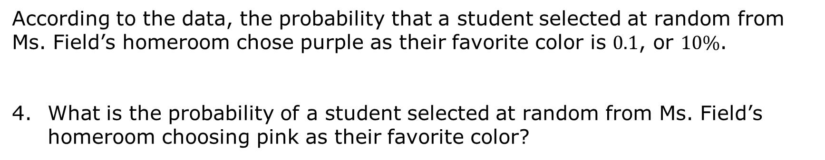
According to the data, the probability that a student selected at random from Ms. Field’s homeroom chose purple as their favorite color is $0.1$, or $10\%$.
What is the probability of a student selected at random from Ms. Field’s homeroom choosing pink as their favorite color?
volume 1, pg. 187

Slide 15
What is the probability that a student selected at random from Ms. Field’s homeroom did not choose orange as their favorite color?
volume 1, pg. 187

Slide 16

Guided Practice
volume 1, pg. 187

Slide 17

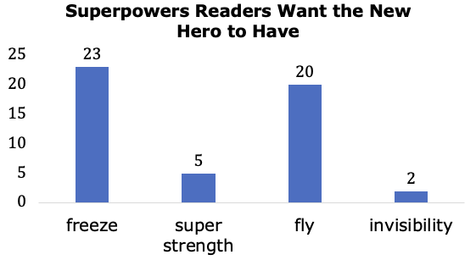
5.2.3 Guided Practice: Determine the Probability
Fifty readers of the comic The Probability Princess were surveyed on what superpower they would like for the new hero in the series to have. The results are in the bar chart below.
volume 1, pg. 187

Slide 18

If these $50$ people are representative of all the readers of The Probability Princess, what is the probability a reader of the series chosen at random wants the new hero to have the power of invisibility?
volume 1, pg. 187

Slide 19
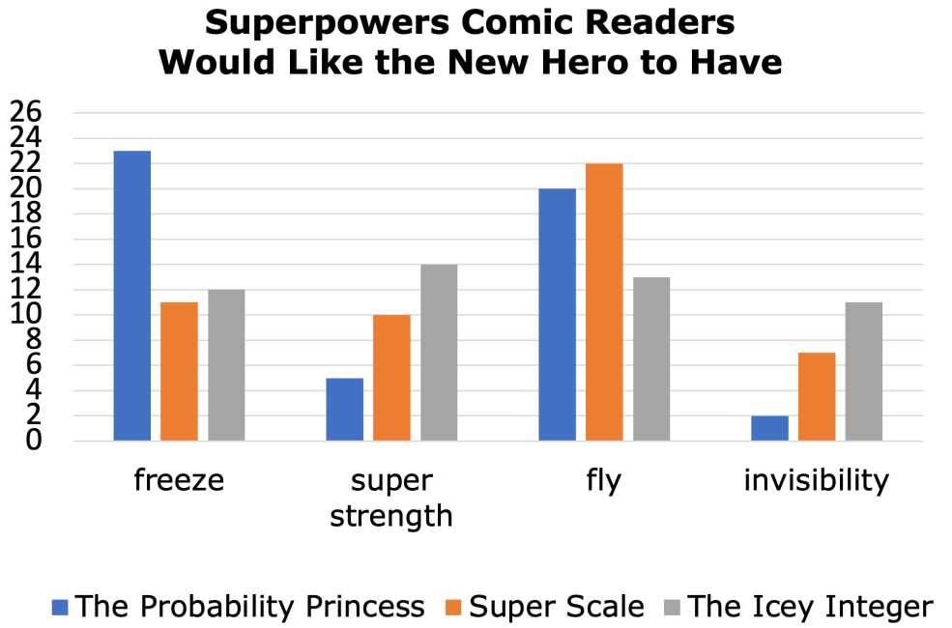
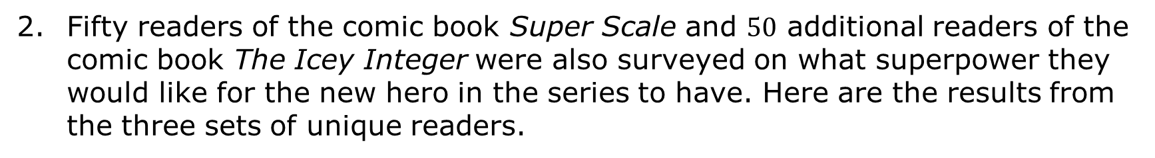
Fifty readers of the comic book Super Scale and $50$ additional readers of the comic book The Icey Integer were also surveyed on what superpower they would like for the new hero in the series to have. Here are the results from the three sets of unique readers.
volume 1, pg. 188

Slide 20
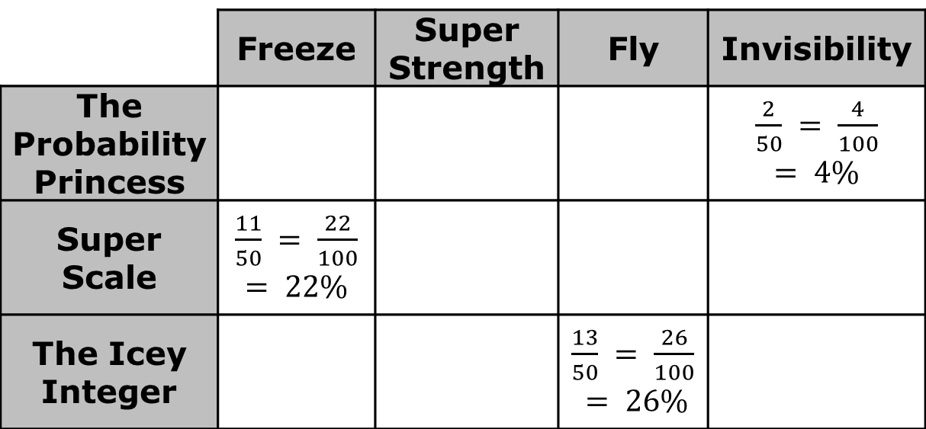
Complete the table to show the probability of each superpower that a randomly selected reader from each category wants the series’ new hero to have. Some of the probabilities have already been completed in the table.
 | Freeze | Super Strength | Fly | Invisibility
The Probability Princess |  |  |  | $\frac{2}{50} = \frac{4}{100}$ $$= 4\%$$
Super Scale | $\frac{11}{50} = \frac{22}{100}$ $$= 22\%$$
The Icey Integer |  |  | $\frac{13}{50} = \frac{26}{100}$ $$= 26\%$$
volume 1, pg. 188

Slide 21
If a reader is chosen at random, which superpower are they most likely to want the new hero to have?
 | Power | Probability
The Probability Princess
Super Scale
The Icey Integer
volume 1, pg. 188

Slide 22

Using the probabilities, work with your partner to complete the statements.
The writers of The Probability Princess
give the new hero the ability to fly because …
The writers of Super Scale give
the new hero the ability to fly because …
The writers of The Icey Integer give
the new hero the ability to fly because …
volume 1, pg. 188

Slide 23
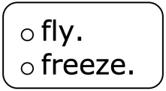

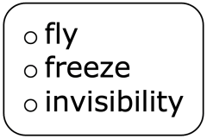
Complete the summary.
Readers of three different comic books were surveyed on what superpower they want the new hero in the series to have. If a reader of any of the three series is chosen at random, they are most likely to say the new hero should have the power to This was also the most common response in readers of However, readers of The Probability Princess are more likely to choose for the new hero’s superpower.
volume 1, pg. 189

Slide 24
The survey shows these readers are nearly evenly distributed among the four choices, making it difficult to predict which power a reader chosen at random from this group would prefer the new hero to have.
volume 1, pg. 189

Slide 25
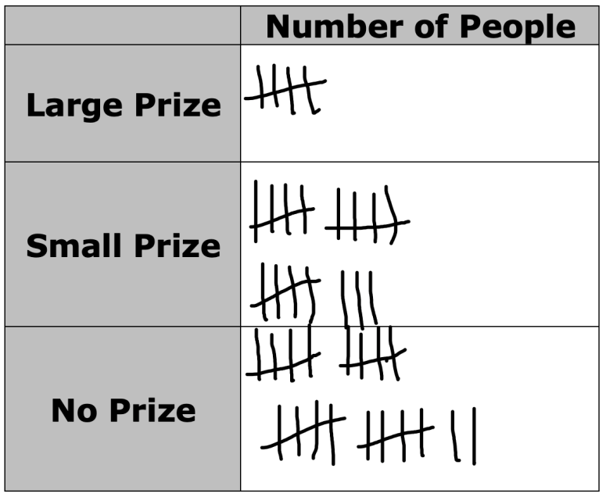
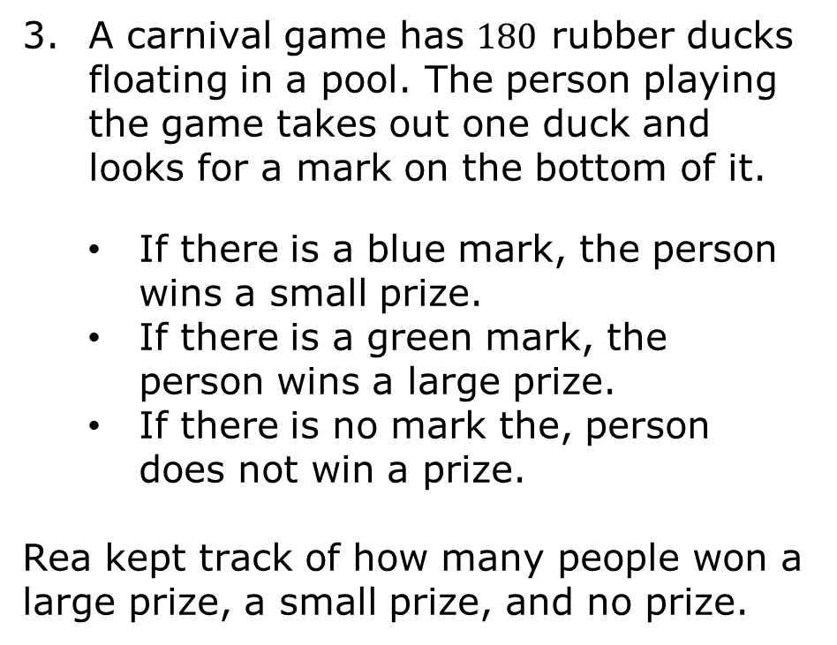
A carnival game has $180$ rubber ducks floating in a pool. The person playing the game takes out one duck and looks for a mark on the bottom of it.
If there is a blue mark, the person wins a small prize.
If there is a green mark, the person wins a large prize.
If there is no mark the, person does not win a prize.
Rea kept track of how many people won a large prize, a small prize, and no prize.
volume 1, pg. 189

Slide 26
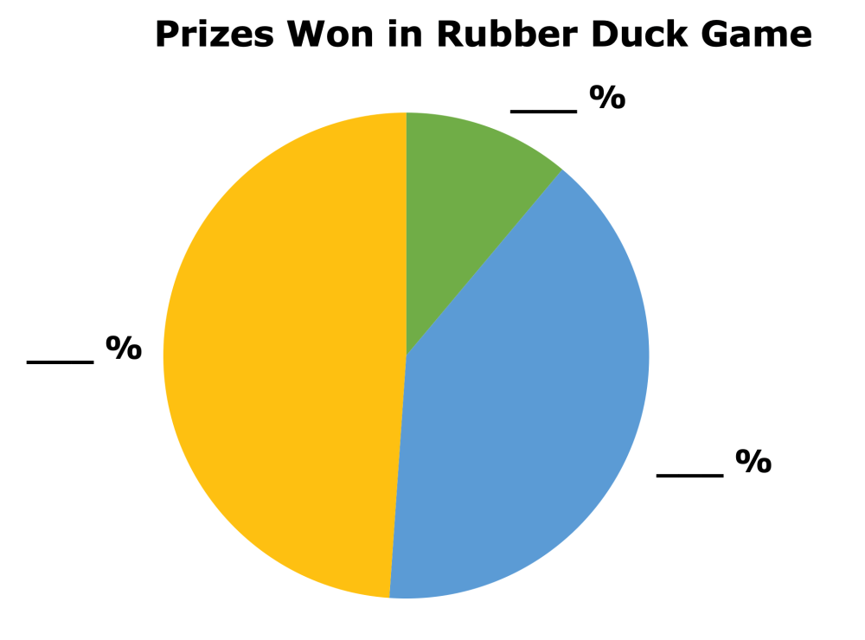
Rea made a circle graph of the results, but she forgot to label the sections of the graph. Use her data to correctly label the sections of the circle graph.
volume 1, pg. 190

Slide 27
Use the circle graph to determine the probability of winning a large prize.
Explain how to use the circle graph to determine the probability of winning either a large prize or a small prize.
volume 1, pg. 190

Slide 28

Your Turn
volume 1, pg. 190

Slide 29

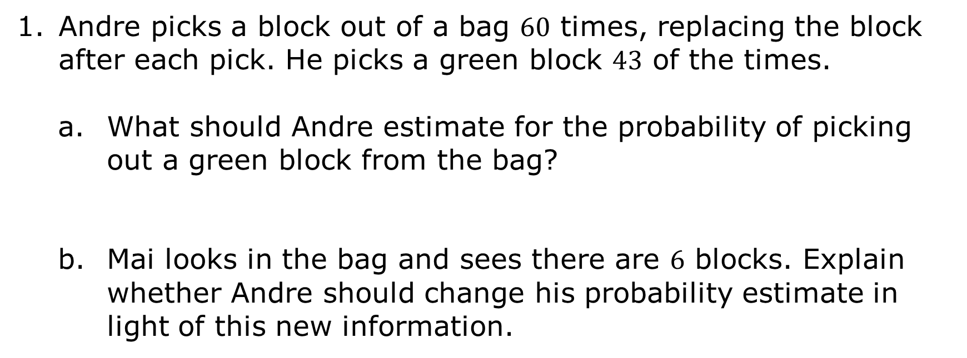
5.2.4 Your Turn!
Andre picks a block out of a bag $60$ times, replacing the block after each pick. He picks a green block $43$ of the times.
What should Andre estimate for the probability of picking out a green block from the bag?
Mai looks in the bag and sees there are $6$ blocks. Explain whether Andre should change his probability estimate in light of this new information.
volume 1, pg. 190

Slide 30
Before a number cube is sold, it is subjected to rigorous testing. The table below shows how one number cube performed on its three rounds of rolling tests. Based on these results, write a recommendation explaining whether or not this number cube is functioning properly and should be sold.
 | Rolling Test 1 | Rolling Test 2 | Rolling Test 3
Number of Sixes Rolled | 40 | 42 | 33
Total Number of Rolls | 100 | 100 | 100
volume 1, pg. 190

Slide 31

Wrap-Up
volume 1, pg. 191

Slide 32
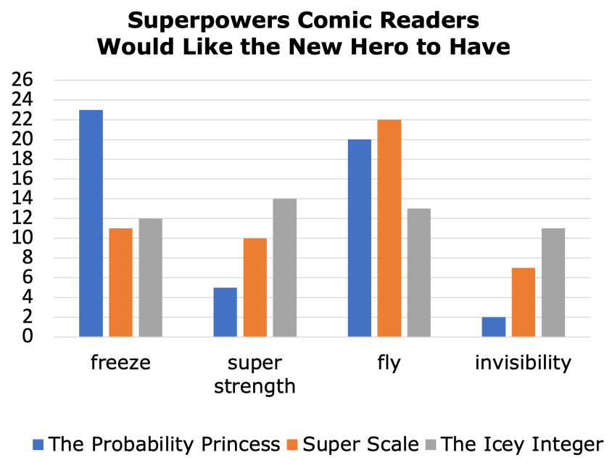
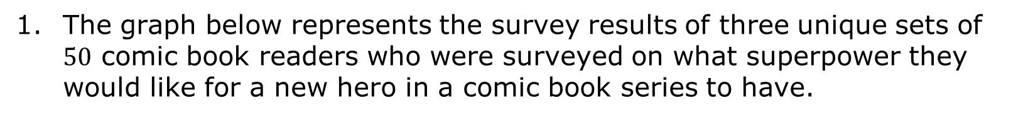
5.2.5 Wrap-Up: Ticket Out the Door
The graph below represents the survey results of three unique sets of $50$ comic book readers who were surveyed on what superpower they would like for a new hero in a comic book series to have.
volume 1, pg. 191

Slide 33
What is the probability that a randomly selected reader of any of the three comics wants the new hero in the series to have the power of invisibility?
How does the probability of a reader of Super Scale wanting the new hero to have the ability to fly compare to the probability of a reader of any of the three comic books wanting the new hero to have super strength?
volume 1, pg. 191

